Slide 1
Principles of Electrical Engineering: Capacitance & Capacitor
Prepared by,
Prof. Divyang S. Jadav
(Assistant Professor, STME)

Slide 2
What is Capacitor?
Different bodies hold different charge when given the same potential. This charge holding property of a body is called capacitance or capacity of the body.
Any two conducting surfaces separated by an insulating material is called a capacitor or condenser. Its purpose is to store charge in a small space.
The conducting surfaces are called the plates of the capacitor and the insulating material is called the dielectric. The most commonly used dielectrics are air, mica, waxed paper, ceramics etc.
The following points may be noted carefully :
The ability of a capacitor to store charge (i.e. its capacitance) depends upon the area of plates, distance between plates and the nature of insulating material (or dielectric).
A capacitor is generally named after the dielectric used e.g. air capacitor, paper capacitor, mica capacitor etc.
The capacitor may be in the form of parallel plates, concentric cylinder or other arrangement.

Slide 3
How does a capacitor charge?

Slide 4
How does a capacitor charge?
The following points may be noted about the action of a capacitor :
When a d.c. potential difference is applied across a capacitor, a charging current will flow until the capacitor is fully charged when the current will cease. This whole charging process takes place in a very short time, a fraction of a second. Thus a capacitor once charged, prevents the flow of direct current.
The current does not flow through the capacitor i.e. between the plates. There is only transference of electrons from one plate to the other.
When a capacitor is charged, the two plates carry equal and opposite charges (say + Q and –Q). This is expected because one plate loses as many electrons as the other plate gains. Thus charge on a capacitor means charge on either plate.
The energy required to charge the capacitor (i.e. transfer of electrons from one plate to the other) is supplied by the battery.

Slide 5
Capacitance
The ability of a capacitor to store charge is known as its capacitance.
It has been found experimentally that charge Q stored in a capacitor is directly proportional to the p.d. V across it i.e.
The ratio of charge on capacitor plates to the p.d. across the plates is called capacitance of the capacitor.

Slide 6
Unit of Capacitance
The SI unit of charge is 1 coulomb and that of voltage is 1 volt. Therefore, the SI unit of capacitance is one coulomb/volt which is also called farad (Symbol F) in honour of Michael Faraday.
1 farad = 1 coulomb/volt
A capacitor is said to have a capacitance of 1 farad if a charge of 1 coulomb accumulates on each plate when a p.d. of 1 volt is applied across the plates.
Thus if a charge of 0·1C accumulates on each plate of a capacitor when a p.d. of 10V is applied across its plates, then capacitance of the capacitor = 0·1/10 = 0·01 F.
The farad is an extremely large unit of capacitance. Practical capacitors have capacitances of the order of microfarad (μF) and micro-microfarad (μμF) or picofarad (pF).

Slide 7
Factors affecting Capacitance
Area of plate. The greater the area of capacitor plates, the larger is the capacitance of the capacitor and vice-versa
Thickness of dielectric. The capacitance of a capacitor is inversely proportional to the thickness (i.e. distance between plates) of the dielectric. The smaller the thickness of dielectric, the greater the capacitance and vice-versa.
Relative permittivity of dielectric. The greater the relative permittivity of the insulating material (i.e., dielectric), the greater will be the capacitance of the capacitor and vice-versa.

Slide 8
Dielectric Constant or Relative Permittivity
The insulating material between the plates of a capacitor is called dielectric.
When the capacitor is charged, the electrostatic field extends across the dielectric.
The presence of dielectric increases the concentration of electric lines of force between the plates and hence the charge on each plate.
The degree of concentration of electric lines of force between the plates depends upon the nature of dielectric.
The ability of a dielectric material to concentrate electric lines of force between the plates of a capacitor is called dielectric constant or relative permittivity of the material.

Slide 9
Dielectric Constant or Relative Permittivity
Hence dielectric constant (or relative permittivity) of a dielectric material is the ratio of capacitance of a capacitor with that material as a dielectric to the capacitance of the same capacitor with air as dielectric.

Slide 10
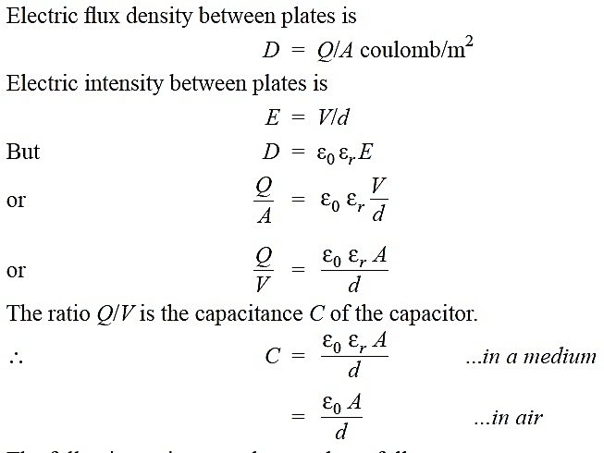
Capacitance of Parallel-Plate Capacitor with Uniform Medium

Slide 11
Capacitance of Parallel-Plate Capacitor with Uniform Medium

Slide 12
Parallel-Plate Capacitor with Composite Medium

Slide 13
Parallel-Plate Capacitor with Composite Medium
Suppose the space between the plates is occupied by three dielectrics of thicknesses d₁, d₂and d₃ metres and relative permittivities ε_{r1}, ε_{r2} and ε_{r3} respectively as shown in figure.
The electric flux density D in the dielectrics remains the same and is equal to Q/A.
However, the electric intensities in the three dielectrics will be different and are given by ;

Slide 14
Parallel-Plate Capacitor with Composite Medium
Medium partly air:
When dielectric slab introduced:

Slide 15
Special Cases of Parallel-Plate Capacitor

